Slide 1
Training All Students as Leaders and Change Agents
Rachel Allen, Pharm.D.
Kelsey Brantner, B.S.
Curtis G. Jefferson, M.S.
Nanci Murphy, Pharm.D.
Shannon Panther, Pharm.D., BCACP
Jennifer D. Robinson, Pharm.D.

Slide 2
Disclosure
During this presentation we will be discussing how we utilized Clifton StrengthsFinder program. We are not commercially supporting or endorsing Clifton StrengthsFinder, just providing information about how we used this product as part of our broader leadership development approach.

Slide 3
Learning Objectives
Discuss the skillset needed by a Doctor of Pharmacy graduate in the next 5-10 years.
Identify how leadership skills can be effectively taught and assessed in a required course in a doctor of pharmacy curriculum.
Discuss lessons learned and recommendations for offering this type of curricula.

Slide 4
Training the Pharmacist of the Future

Slide 5
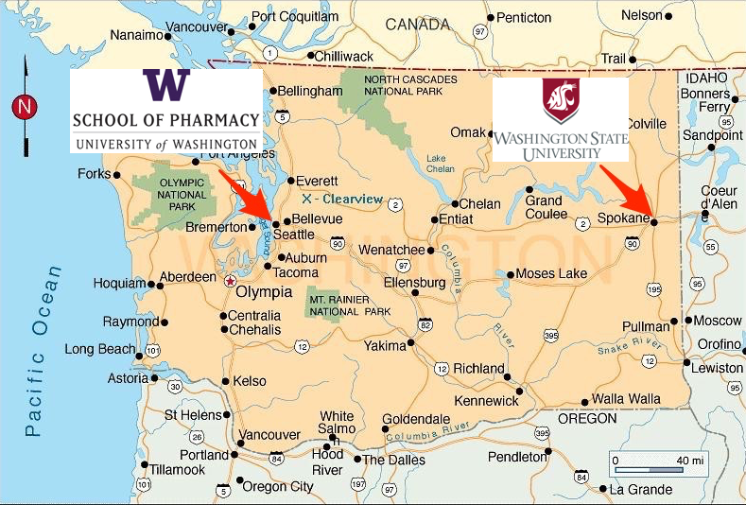
Overview of Practice in Washington

Slide 6
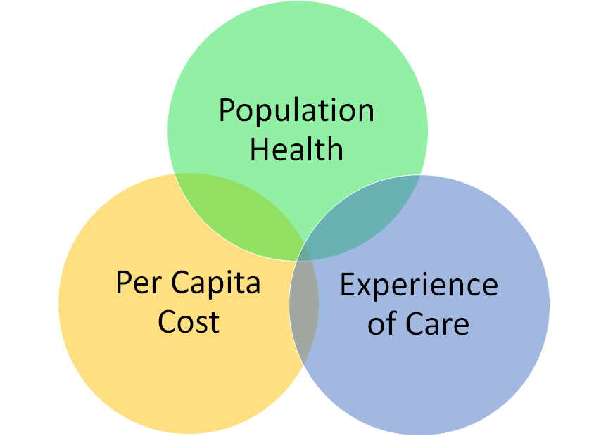
IHI Triple Aim

Slide 7
Active Learning: Brainstorm
What is your vision for the skillset that a pharmacist will need to practice pharmacy in the near future?

Slide 8
CAPE Educational Outcomes
Student Pharmacists should develop the following skills or attributes; learner, caregiver, manager, promoter, provider, problem solver, educator, advocate, collaborator, includer, communicator, self-aware, leader, innovator and professional.

Slide 9
Course Structure

Slide 10
IPPE Course Structure
UW | WSU
Fall PY2, immediately after Community IPPE
Quarters | Semesters
Classes every other week | Classes every week
Credit/No Credit 84% threshold to earn credit | Graded Professionalism Credit
Asynchronous Delivery

Slide 11
Course Coordination Across Universities
Scheduled calls
Maintained call notes with assigned tasks
Google docs vs. Dropbox
Deadlines
IOR calls approximately one week prior to module

Slide 12
4 Course Foundations
Application in Community Pharmacy
Teamwork
Leadership
Strengths

Slide 13
Pre-Course Survey
Pre-Course survey utilized to determine each student’s prior background with:
Leadership and change
Strengths
Teamwork
Implementing a new service and/or improving existing service in a community pharmacy setting
Assessed baseline perceptions regarding each student’s perceived abilities in the above areas
Completion required before classes began

Slide 14
Module 1
Leadership
Application in Community Pharmacy
The Future of Pharmacy Practice
IHI Triple Aim
Introduction to Clinical Service Project

Slide 15
Module 1 Design
Introduced to 4 foundations of course
Leadership, Strengths, Teamwork, Application in Community Pharmacy
Introduced Clinical Community Project & Community Pharmacy Partners
Watched videos from Rear Admiral Scott Giberson and APhA CEO Tom Menighan
Team formation
Homework:
Report to the U.S. Surgeon General Assignment
IHI Assignment
Complete Project Guide Parts 1-3

Slide 16
Video:
Rear Admiral (RADM) Scott Giberson

Slide 17
Report to the Surgeon General Learning Objectives and IHI Triple Aim
The Future of Pharmacy Practice
Demands on healthcare delivery , pharmacist’s role, determine the professional development steps needed to meet the need
Outline IHI Triple aim goals and achievement with a new or enhanced clinical service
Leadership regardless of title and characteristic of effective leaders
Develop knowledge of organizational culture.

Slide 18
Clinical Community Pharmacy Project
3 Part Purpose
Create, develop, and outline necessary implementation measures for a clinical service
To Achieve
One or more of the IHI Triple Aim goals
To Advance
The practice of pharmacy
Apply knowledge gained during the Community IPPE

Slide 19
Clinical Community Pharmacy Project
Groups
Self-selected
Group Size
UW: 4-5
WSU: 7-8
Full autonomy over project idea ultimately pursued
Some in-class time, but largely completed outside of class

Slide 20
Challenge-Based Learning
Groups worked through a Challenge-based project guide to assist with the development of a new or enhanced clinical service.
based on Apple’s Challenge-based learning model
adapted to fit the goals of this project
Benefits of Challenge Based Learning:
Hands on & collaborative
Encourages use of technology
Uses creativity to develop solutions
Solves real-world challenges

Slide 21
Community Pharmacy Partners
Pharmacists with a track record of innovation at their practice sites
Pharmacists actively engaged in professional organizations and/or their communities
Pharmacists who were supportive and experienced preceptors
Pharmacists who were knowledgeable in the process for enhancing current or developing new services (e.g., business plans, marketing strategy, and financial analysis)

Slide 22
Module 2
Leadership
Strengths
Application in Community Pharmacy
Leading Change (UW)
Determining Personal Strengths

Slide 23
Module 2 Design
Kotter’s 8 steps for Leading Change (reviewed in class at UW)
Community IPPE Project Time
Homework:
Strengths Assessment Assignment
Personal Strengths Reflection
Complete Project Guide Part 4
Notes:
.

Slide 24
Kotter’s 8-Step Process for Leading Change
Institutionalize the Change
Build on the Change
Create Quick Wins
Empower Others to Act on the Vision
Communicate Decisions
Create a Vision
Form a Guiding Coalition (team)
Create Urgency
"Kotter's 8-Step Change Model." Mind Tools: Essential Skills for an Excellent Career. Mind Tools Ltd., 2010. Web. 17 Feb. 2016.

Slide 25
Clifton StrengthsFinder
30-minute online assessment, the Clifton StrengthsFinder
“After you take the Clifton StrengthsFinder, you'll receive a customized report that lists your top five talent themes, along with action items for development and suggestions about how you can use your talents to achieve academic, career, and personal success.”

Slide 26
The Four Domains of Leadership Strength
Executing | Influencing | Relationship Building | Strategic Thinking
Achiever Arranger Belief Consistency Deliberative Discipline Focus Responsibility Restorative | Activator Command Communication Competition Maximizer Self-assurance Significance Woo | Adaptability Developer Connectedness Empathy Harmony Includer Individualization Positivity Relator | Analytical Context Futuristic Ideation Input Intellection Learner Strategic
Clifton, Donald O. StrengthsQuest: Discover and develop your strengths in academics, career, and beyond. Gallup Pr, 2002.
Adapted from StrengthsQuest Four Domains “What Makes a Great Leadership Team?”. 2009.

Slide 27
Module 3
Strengths
Teamwork
Application in Community Pharmacy
Applying personal strengths to a team and organization

Slide 28
Module 3 Design
In class presentation on strengths by Leslie Fox
Healthcare Policy and Advocacy Director at Johnson & Johnson
Discussion on strengths in teams and how to use strengths strategically
Homework:
Team Strengths Reflection (HW for UW, covered in Module 4 for WSU)
Complete Project Guide Parts 5-6

Slide 29
Active Learning: Brainstorm
Strengths Application

Slide 30
Module 4
Application in Community Pharmacy
Teamwork
Leadership
Strengths
Community Project Pitch Preparation
Putting it all together

Slide 31
Module 4 Design
In class project prep time &/or team strengths discussion follow up
Final time for review of grading rubric and questions regarding project pitch
Homework:
Project Pitch Preparation

Slide 32
Module 5
Application in Community Pharmacy
Teamwork
Leadership
Strengths
Project Pitch Presentations

Slide 33
Module 5 Design
Presentations given live to classmates, teachers, and community pharmacy partners
Panel of community partners ideal for the presentation evaluation (UW)
All presentations evaluated in real time, but were also recorded
High scoring projects that drew community partner interest in implementation were invited to continue their project
Homework:
Team Member Evaluation
Post Course Survey

Slide 34
5 Minute Project Pitch
A final project overview was presented to practicing Community Pharmacists and the class at the conclusion of the course.
This presentation was each team’s sales pitch for the project.
The pitch had to be 5 minutes or less.
The audience was encouraged to ask questions on material that is unclear.
The pitch could be presented as a verbal presentation, video, skit, etc.
Students were provided with a project “pitch” guide & rubric to help you prepare.

Slide 35
Quotes from Community Partners
Jenny Arnold, Pharm.D., BCPS, Director of Practice Development - Washington State Pharmacy Association:
“Having the students present their Leadership Projects, in only 5 minutes gave them the challenge of refining their work down to the essence, and presenting just the most important aspects. This is a great skill for any pharmacist to have when they want to promote something to leaders, their patients or the community.”
Beverly Katterman, Clinical Professor, Owner Katterman’s Sand Point Pharmacy:
"I think that all the groups should receive an A for thinking outside of the box."

Slide 36
Implementation

Slide 37
How Groups Were Chosen for Implementation
Ranked based on presentation rubric
Highly ranked projects were given the option to implement project
(UW) community partners gave input on what projects could be implemented at their pharmacy; other student groups were given options for implementation at other sites
(WSU) Highly ranked projects were given the option of contacting other community pharmacies if their project could not be done with the original community partners

Slide 38
Highlights of student projects

Slide 39
Project Implementation WSU
Creation of rural health care screening services in three North Idaho pharmacies
Student lead development and delivery of a MTM elective course for fellow student pharmacists

Slide 40
Project Implementation UW
Assist community pharmacists in improving
5-star ratings criteria related to medication adherence
2) Expand the pharmacist’s involvement in management of patients diagnosed with heart failure in clinic settings
Notes:
Update to Nanci’s new wording…

Slide 41
Assessment
Student Confidence
Kotter’s 8 Steps of Change
Factors Influencing Change in Confidence
Pitch Presentations
Key Takeaways

Slide 42
Student Confidence
Seven questions asked on pre and post surveys
Assessed using PRE-THEN-POST model
Statistically significant increases in PRE-POST and THEN-PRE scores in all seven areas

Slide 43
Student Confidence
Confidence Area (n=191) | Then (SD) | Pre (SD) | Post (SD) | p
Leading Change | 54.895 (3.139) | 63.474 (3.072) | 70.947 (2.46) | p < 0.001
Identifying & Describing Personal Strengths | 61.368 (2.711) | 73.789 (2.651) | 80.947 (2.154) | p < 0.001
Identifying & Fostering Strengths in Others | 60.211 (2.948) | 68.534 (2.716) | 75.211 (2.557) | p < 0.001
Identifying New Services | 52.316 (3.066) | 58.482 (3.149) | 72.105 (2.48) | p < 0.001
Developing a Plan | 52.632 (3.247) | 58.337 (3.113) | 75.053 (2.512) | p < 0.001
Implementation | 54.421 (3.394) | 61.414 (3.122) | 73.579 (2.523) | p < 0.001
Creative Decision-making | 57.526 (3.238) | 63.351 (3.176) | 74.737 (2.599) | p < 0.001

Slide 44
Kotter’s 8 Steps of Change
Asked students for areas where they feel they improved and where they feel comfortable
Top 3 in Both Areas
Communicate Decisions
Create a Vision
Form a Guiding Coalition (team)

Slide 45
Kotter’s 8 Steps of Change
Improved Areas in Leading Change (n=192) | Number | %
Create Urgency | 56 | 29.17
Form a Guiding Coalition (team) | 106 | 55.2
Create a Vision | 124 | 64.58
Communicate Decisions | 142 | 73.96
Empower others to act on the vision | 91 | 47.4
Create Quick Wins | 59 | 30.73
Build on the Change | 84 | 43.75
Institutionalize the Change | 49 | 25.52

Slide 46
Kotter’s 8 Steps of Change
Comfortable Areas of Leading Change (n=192) | Number | %
Create Urgency | 75 | 39.06
Form a Guiding Coalition (team) | 105 | 54.69
Create a Vision | 118 | 61.46
Communicate Decisions | 145 | 75.52
Empower others to act on the vision | 96 | 50
Create Quick Wins | 66 | 34.38
Build on the Change | 100 | 52.08
Institutionalize the Change | 49 | 25.52

Slide 47
Influencers of Change in Confidence
Students asked to identify what contributed to changes in leadership confidence

Slide 48
Influencers of Change in Confidence
Factors Influencing Change In Confidence (n=128) | Number | %
Group Project | 73 | 57.03
Learning About Change | 35 | 27.34
Strengths Finder | 27 | 21.09
Motivation/Drive | 10 | 7.81
Learning About Leadership | 9 | 7.03
Increased Knowledge of Pharmacy Practice | 3 | 2.34
IPPE | 3 | 2.34

Slide 49
Pitch Presentations
Average student performance on pitch presentations was 26.47 on 30-point scale
Reviewers reported being very impressed with overall quality of student work

Slide 50
Key Takeaways
Students report feeling more confident and comfortable with leadership and change
Students report group project as the most commonly cited factor in influencing this change

Slide 51
Recommendations

Slide 52
Recommendations for the Design, Implementation and Evaluation of this Curriculum
Assemble your team with individuals who have diverse skill sets or experience in the following areas:
Change leaders in practice
Curriculum development
Assessment methods
Operations and technology
Effective teachers and facilitators
Expertise in improvement/implementation science
Complementary attributes/personal strengths

Slide 53
Curriculum Development
Review and revise (if needed) your school’s educational outcomes in these areas
Conduct a curriculum mapping exercise to identify gaps and ideal points to embed learning content and activities
Identify your assessment methods
Ensure plenty of time to receive approval for resources used in your curricula

Slide 54
Community Partner Roles
Identify community partners and seek their assistance in curriculum development, class presentations, and providing feedback to students
IPPE sites
Intern sites
State association
Your home institution
Others

Slide 55
Identify Project Mentors
Clinical Faculty
School-based and other health sciences faculty
University-based faculty (School of Business, Education, Public Policy, Architecture, etc.)
Leaders in the community/professional associations

Slide 56
Ensure Opportunities for Project Continuation Beyond the IPPE Course
Advanced leadership electives
Practice based research projects
APPEs
Intern site
Independent study

Slide 57
Other Recommendations
Emphasize current and emerging opportunities and the importance of active involvement as a front-line leader
Multiple components of the course involve strong communication and teamwork
Provide reflection opportunities throughout the course

Slide 58
Active Learning: Think Pair Share (group sharing)
What have you done to integrate and assess leadership in core curriculum?

Slide 59
Thank You!
We would like to express our grateful appreciation to all who made this endeavor possible! These include:
RADM Scott Giberson
APhA CEO Thomas Menighan
Leslie Fox
Dr. Jenny Arnold and the WSPA
Eric Kha
Our community pharmacy partners
Anne Marie Kondic and the Community Pharmacy Foundation!
We would also like to thank our student pharmacists for their enthusiasm and their continuing desire to practice at the “top of their license,” in service to their patients and their communities! We are very proud of you and want you to know that you inspire us each and every day!
Thank you to everyone in attendance for your time, attention, and participation!

Slide 60
Question & Answer

Slide 61
References
Stiefel M, Nolan K. A Guide to Measuring the Triple Aim: Population Health, Experience of Care, and Per Capita Cost. IHI Innovation Series white paper. Cambridge, Massachusetts: Institute for Healthcare Improvement; 2012.http://www.ihi.org/engage/initiatives/TripleAim/Pages/default.aspx
Giberson S, Yoder S, Lee MP. Improving Patient and Health System Outcomes through Advanced Pharmacy Practice. A Report to the U.S. Surgeon General. Office of the Chief Pharmacist. U.S. Public Health Service. Dec 2011.
CAPE Education Outcomes 2013. American Association of Colleges of Pharmacy. http://www.aacp.org/resources/education/cape/Open%20Access%20Documents/CAPEoutcomes2013.pdf. Accessed April 15, 2016.
"Kotter's 8-Step Change Model." Mind Tools: Essential Skills for an Excellent Career. Mind Tools Ltd., 2010. Web. 17 Feb. 2016.
Clifton, Donald O. StrengthsQuest: Discover and develop your strengths in academics, career, and beyond. Gallup Pr, 2002.
Challenge Based Learning A Classroom Guide. Apple. http://www.apple.com/br/education/docs/CBL_Classroom_Guide_Jan_2011.pdf. Accessed April 15, 2016.
ASHP video, “The ‘Elevator Speech’: Prepare, Pitch, and Persuade!”

Slide 62
Continuing Professional Development Activity Evaluation Access
Special Session Leadership Development SIG: Training All Students as Leaders and Change Agents
Passcode: 428298
URL: http://aacp.learningexpressce.com/
UAN: 0581-0000-16-022-L04-P

