Slide 1
HCV Screening and Linkage to Care Program in a Pharmacy Setting
Conveying the Urgency of
HCV Testing

Slide 2
How to Talk about Hepatitis C Testing

Slide 3
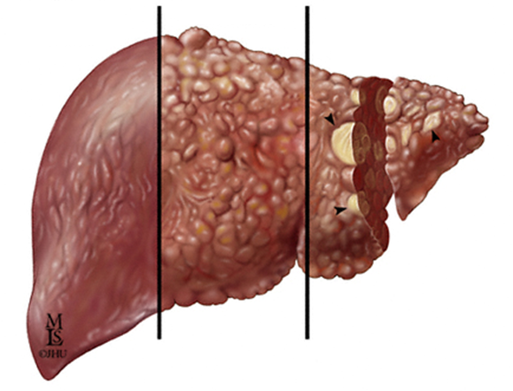
Chronic HCV Infection May Lead to Chronic Liver Disease and Liver Cancer as well as Systemic Disease : DM, Renal Disease, Lymphoma and other problems
^{Fibrosis}
^{Cirrhosis}
^{Hepatocellular Carcinoma}
^{(with cirrhosis)}
Fibrosis¹
Chronic HCV infection can lead to the development of fibrous scar tissue within the liver
HCC³
Cancer of the liver can develop after years of chronic HCV infection
Decompensated cirrhosis:
Ascites
Bleeding gastroesophageal varices
Hepatic encephalopathy
Jaundice
Cirrhosis^{1,2}
Over time, fibrosis can progress, causing severe scarring of the liver, restricted blood flow, impaired liver function, and eventually liver failure
Chronic liver disease includes fibrosis, cirrhosis, and hepatic decompensation; HCC=hepatocellular carcinoma.
1. Highleyman L. Hepatitis C Support Project. http://www.hcvadvocate.org/hepatitis/factsheets_pdf/Fibrosis.pdf. Accessed August 18, 2011; 2. Bataller R et al. J Clin Invest. 2005;115:209-218;
3. Medline Plus. http://www.nlm.nih.gov/medlineplus/enxy.article/000280.htm. Accessed August 28, 2012; 4. Centers for Disease Control and Prevention. http://www.cdc.gov/hepatitis/HCV/HCVfaq.htm. Accessed May 8, 2012.

Slide 4
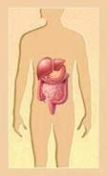
Chronic HCV Infection Affects Many Sites Beyond the Liver
Neurological (e.g. cognitive impairment)
Pulmonary fibrosis
Cardiovascular Diseases
(CAD)
Renal
(e.g. glomerulonephritis)
Metabolic
(e.g. diabetes)
Lymphoproliferative (e.g. B cell lymphoma)
Immune Complex
(e.g. cryoglobulinemic)
Dermatological (e.g. porphyria cutanea tarda)

Slide 5
Identifying Patients with Hepatitis C
4-5 million people in the US have hepatitis C virus (HCV) infection
Most were infected in 1960’s through 1980’s
  Up to 250,000 cases per year in 1980’s
  About 50% infected via IDU, rest from blood transfusions, sex, tattoos, medical procedures, and other factors
Up to 75% of people have not been diagnosed
Risk-based screening misses many people
  Stigma associated with IDU, even if decades ago
Smith BD et al. MMWR. August 17, 2012/61(RR04);1-18. Armstrong GL et al. Ann Intern Med. 2006 May 16;144(10):705-14. http://www.iom.edu/Reports/2010/Hepatitis-and-Liver-Cancer-A-National-Strategy-for-Prevention-and-Control-of-Hepatitis-B-and-C.aspx

Slide 6
HCV is Nearly 4 Times as Prevalent as HIV and HBV
Prevalence of Chronic Viral Infections
4
2.7 to 5 Million¹
75% Unaware of Infection
3
Undiagnosed
Total No. Infected (millions)
Diagnosed
2
1.1 Million¹
21% Unaware of Infection
~800,000 to 1.4 Million¹
65% Unaware of Infection
1
0
HIV
HBV
HCV
A 2011 study estimated that as many as 5.2 million persons are living with HCV in the United States²
HBV=hepatitis B virus; HCV=hepatitis C virus; HIV=human immunodeficiency virus.
Institute of Medicine. Washington, DC: The National Academies Press; 2010.
Chak E, et al. Liver Int. 2011;31(8):1090-1101.
Gish Hepatology 2015

Slide 7
Efficient Identification of Patients with HCV
4 -5 million people with HCV in US
50 million “risk identified” or ~80 million 1945-1965 cohort who need to be tested for HCV in US¹
25% diagnosed with HCV
Treatment and Management
Improve Diagnosis
¹Tomaszewski Am J Public Health 2012; 102 (11):e101

Slide 8
Current Status of HCV in the US: Screening and Linkage to Care Rates Remain Low
US population with chronic HCV infection
3.2-5 million
HCV detected
1.6 million (25-50%)
Referred to care
1.0 – 1.2 million (<32%-38%)
HCV RNA test
630,000 – 750,000 (<20-23%)
Liver biopsy
380,000 – 560,000 (<12%-18%)
Treated
220,000 – 360,000 (<7-11%)
Successfully treated
170,000 – 200,000 (<5-6%)
As modified from: Holmberg SD et al, New Engl J Med. 2013; 1859-1861.
as modfied with
Gish Hepatology 2015

Slide 9
Who Should Be Tested for HCV
CDC Recommendations
Everyone born from 1945 through 1965 (one-time)
Persons who ever injected illegal drugs
Persons who received clotting factor concentrates produced before 1987
Chronic (long-term) hemodialysis
Persons with persistently abnormal ALT levels.
Recipients of transfusions or organ transplants prior to 1992
Persons with recognized occupational exposures
Children born to HCV-positive women
HIV positive persons
USPSTF Grade B Recs*
Everyone born from 1945 through 1965 (one-time)
Past or present injection drug use
Sex with an IDU; other high-risk sex
Blood transfusion prior to 1992
Persons with hemophilia
Long-term hemodialysis
Born to an HCV-infected mother
Incarceration
Intranasal drug use
Receiving an unregulated tattoo
Occupational percutaneous exposure
Surgery before implementation of universal precautions
*Only pertains to persons with normal liver enzymes; if elevated liver enzymes need HBV and HCV testing
Smith at al. Ann Intern Med 2012; 157:817-822. Moyer et al. Ann Intern Med epub 25 June 2013

Slide 10
HCV Testing: Elevated Liver Enzymes?
Patients with at least 1 clinical encounter and no previous HCV diagnosis | 865,659
Percent tested for HCV | 13%
Percent of tested patients who were HCV positive | 5.1%
Percent patients with ≥2 elevated ALT results tested for HCV | 43.9%
Percent positive for HCV after ≥2 elevated ALT results | 8.2%
Study included patients followed at Kaiser Permanente of Hawaii and Oregon, Henry Ford Health System, Detroit, and Geisinger Health System, PA
Spradling et al CID 2012; 55:1047-55.

Slide 11
Baby Boomers (Born in 1945–1965) Account for 76.5% of HCV in the US¹
1.6
Estimated Prevalence by Age Group²
1.4
1.2
1.0
Number with chronic HCV (millions)
0.8
0.6
0.4
0.2
0
<1920
1920s
1930s
1940s
1950s
1960s
1970s
1980s
1990+
Birth Year Group
An estimated 35% of undiagnosed baby boomers with HCV currently have advanced fibrosis (F3-F4; bridging fibrosis to cirrhosis)³
1. Centers for Disease Control and Prevention. MMWR. 2012;61:1-32; Adapted from Pyenson B, et al. Consequences of Hepatitis C Virus (HCV): Costs of a baby boomer Epidemic of Liver Disease. New York, NY: Milliman, Inc; May 18, 2009. http://www.milliman.com/expertise/healthcare/publications/rr/consequences-hepatitis-c-virus-RR05-15-09.php Milliman report was commissioned by Vertex Pharmaceuticals; 3. McGarry LJ et al. Hepatology. 2012;55(5):1344-1355.

Slide 12
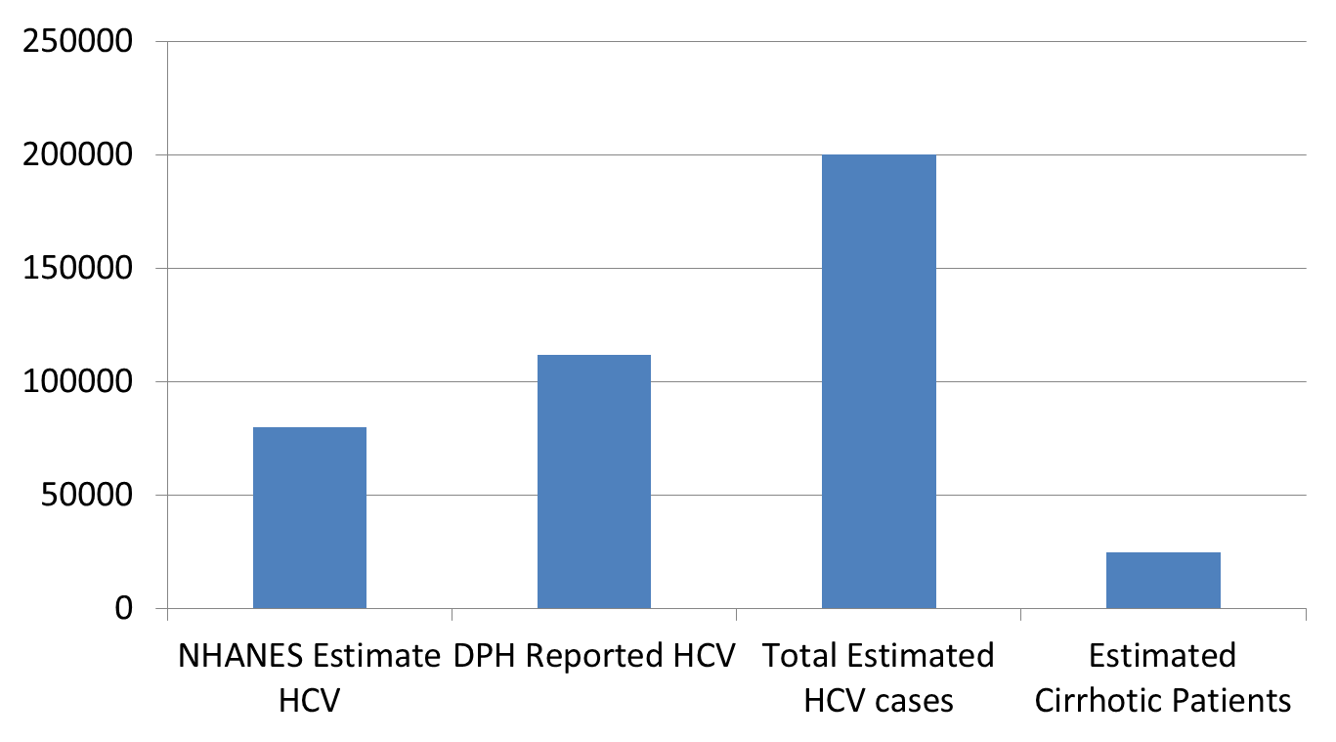
Estimates of People with HCV in MA
MA adult population = 5.8 million
¹Personal communication, Daniel Church, MA DPH; ²Smith; MMWR. August 17, 2012/61(RR04); 1-18. ³http://www.census.gov/prod/cen2010/briefs/c2010br-03.pdf. ⁴Armstrong; Ann Int Med 2006; 144:705-14. ⁵Davis; Gastro 2010; 138:513-21

Slide 13
WA State HCV Epidemiology
Between 2000-11, there were 69,459 reported cases of Hep C
  62% male
  Most were 35-54 yo
  5800 cases diagnosed annually
  2013: 63 acute cases (0.9 cases/100,000 population) were reported, including one case exposed perinatally
  45 of 54 cases interviewed had injection drug use as a risk factor
Washington State Chronic Hepatitis B and Chronic Hepatitis C Surveillance Report. WA State DOH, Apr 2013; Washington State COMMUNICABLE DISEASE REPORT 2013

Slide 14
Projected Burden of Advanced Fibrosis
Over the Next Decade
1990 → 77.6% F0/1;
cirrhosis =5%
2010 → 41.8% F0/1;
cirrhosis =25%
2020 → cirrhosis = 37.2%
Davis GL, Gastroenterology. 2010;138:513-521.

Slide 15
Timing of Mortality Among Known HCV Cases in Massachusetts, 1992-2009
Median interval: 3 years
Median age: 53 years
76,122 HCV diagnoses were reported to the MDPH between 1992 and 2009, 8,499 of these reported HCV cases died and are represented in the figure. Data as of 1/11/2011.
Lijewski, et al, 2012

Slide 16
Importance of State-Specific HCV Epidemiology Data
Education of primary care providers:
  Personalize the importance of hepatitis C as a disease they will see and manage
  Increase interest in implementation of HCV screening programs in their health systems
Increase awareness with policy makers
  Advocate for legislation
  Mobilize resources for local and state departments of public health
Encourage community awareness and advocacy

Slide 17
State-Level Hepatitis C Data
State viral hepatitis coordinators spear-head state-level research with minimal resources
NVHR is helping NASTAD showcase hepatitis C data by state

Slide 18
PCP Barriers at CareGroup Boston Mass
Recommendations to test everyone born from 1945 - 1965 means testing too many people and this is too expensive
There is no need to screen since clinicians can identify people who have clinically significant liver disease by their clinical presentation and will test for HCV at that point
Patients will die with their HCV, not of it, and a lot of patients will be upset/harmed by this testing in an effort to identify the few who will actually develop significant disease
There is nothing to do for HCV (if not aware that HCV is potentially curable) or, the treatment is more toxic than the disease
Everybody with anti-HCV antibody seropositivity has active HCV infection
There are too many electronic medical records prompts already and any more will overwhelm clinicians

Slide 19
Steps to Implement Birth Cohort HCV Testing
Core team: Pharmacy, Primary Care, Infectious Disease, Hepatology, Database Management, and Clinical Pathology

Slide 20
Initial Hepatitis C Testing and Evaluation
Who Should Be Tested for Hepatitis C?
New: Anyone born between 1945 and 1965 should be tested once, regardless of risk factors
In addition, patients with the following risk factors:
Elevated ALT (even intermittently)
A history of illicit injection drug use or intranasal cocaine use (even once)
Needle stick or mucosal exposure to blood
Current sexual partners of HCV infected persons
Received blood/organs before 1992
Received clotting factors made before 1987
Chronic hemodialysis
Infection with HIV
Children born to HCV-infected mothers
Negative (-)
STOP here if no concern for acute infection or severe immunosuppression. If so, check HCV RNA.
Hepatitis C Antibody (HCV Ab)¹
Positive (+)
Negative (-)
These people are NOT chronically infected.
Detectable HCV Ab with negative HCV RNA can occur with spontaneous clearance of infection ( about 25% of people exposed to HCV will clear; verify HCV RNA negative in 4 to 6 months) or with treatment of HCV.
Check HCV RNA (viral load)
Positive (+)
Hepatitis C infection
¹Example ICD-9 codes for HCV antibody testing:
V73.89: screening for other specified viral disease
790.4: nonspecific elevation of levels of transaminase; use if patient ever had an elevated ALT
Why Test People Born Between 1945-1965?
76% of the ~4 million people with HCV infection in the US are baby boomers
In the 1945-1965 cohort:
  All: 1 out of 30
  Men: 1 out of 23
  African American men: 1 out of 12
Up to 75% do not know they have HCV
73% of HCV-related deaths are in baby boomers
Evaluation and referral
Counsel Patients with HCV Infection About Reducing Risk of Transmission
Do not donate blood, body organs, other tissue, or semen
Do not share personal items that might have small amounts of blood (toothbrushes, razors, nail-grooming equipment, needles) and cover cuts and wounds
HCV is not spread by hugging, kissing, food or water, sharing utensils, or casual contact
If in short term or multiple relationships, use latex condoms. No condom use is recommended for long-term monogamous couples (risk of transmission is very low)
What Can Happen to People with Hepatitis C?
It is important to identify if patients have cirrhosis
Patients with cirrhosis are at risk for liver cancer (HCC) and liver decompensation (ascites, variceal bleed, hepatic encephalopathy, jaundice)
Hepatitis C is curable, and cure reduces the risk of severe complications, even with cirrhosis
Refer patients to a specialist who has experience treating hepatitis C to see if they need treatment
Initial Management
Evaluate alcohol use (CAGE, AUDIT-C) and recommend stopping use
Vaccinate for hepatitis A and hepatitis B if not previously exposed
Evaluate sources of support (social, emotional, financial) needed for HCV treatment
Reduce weight to a normal BMI
No THC Marijuana
Smith BD et al. MMWR. August 17, 2012/61(RR04); 1-18. Adapted from Winston et al. Management of hepatitis C by the primary care provider: Monitoring guidelines; 2010; http://www.hcvadvocate.org/hepatitis/factsheets_pdf/PCP_web_10.pdf

Slide 21
PCP Education Example: Screening in Clinic
3 with more advanced fibrosis
1,000 adult patients
330 baby boomers
10 HCV antibody positive
7 HCV RNA positive
4 with mild fibrosis
Efficiently identify birth cohort 1945-1965:
Electronic prompt
~1/3 of adults are in 1945-1965 cohort
1 of 30 baby boomers
1 of 23 men baby boomers
1 of 12 African American men baby boomers
15%-30% of HCV antibody patients will spontaneously clear
Up to 25% of baby boomers may have
cirrhosis
75% of cirrhotic patients are men
Davis, Gastro 2010; 138: 513

Slide 22
Screening of Baby Boomers May Prevent >120,000 Deaths Due to HCV Infection
1,070,840 new cases of HCV identified with birth-cohort screening
552,000 patients treated
364,000 patients cured*
121,000 deaths
averted†
  Birth-cohort screening in primary care would identify 86% of all undiagnosed cases in the birth cohort, compared with 21% under risk based screening¹
  Cost effectiveness of HCV screening is comparable to cervical cancer or cholesterol screening (cost/QALY gained with protease inhibitor+IFN+RBV = $35,700)
Markov chain Monte Carol simulation model of prevalence of hepatitis C antibody stratified by age, sex, race/ethnicity, history of injection drug use, and natural history of chronic hepatitis C.
*With pegylated interferon and ribavirin plus DAA treatment.
†Deaths due to decompensated cirrhosis or hepatocellular carcinoma within 1945-1965 birth cohort. 470,000 deaths under birth cohort screening vs 592,000 deaths under risk-based screening
1. Rein D et al. Ann Intern Med. 2012;156(4):263-270; 2. McGarry LJ et al. Hepatology. 2012;55(5):1344-1355.
Notes:
Key Point
Studies have shown a decreased rate of liver complications in patients who achieved SVR with pegylated interferon alpha and ribavirin.
Notes
The Hepatitis C Antiviral Long-Term Treatment Against Cirrhosis (HALT-C) trial was a multicenter study of 1145 subjects with advanced chronic HCV who were nonresponders to previous interferon-based treatment.
Although SVR rates in patients with advanced hepatic fibrosis were reduced, rates of HCV-associated complications were significantly lower in subjects achieving SVR with pegylated interferon alpha and ribavirin (n=140) compared with nonresponders (n=309):
Decompensated liver disease: 1.4% vs 13.9%
Liver transplantation: 0.7% vs 11.0%
HCC: 1.4% vs 9.1%
Liver-related death: 0.7% vs 6.8%
Because SVR does not eliminate the risk of complications, continued post-treatment monitoring is necessary in these patients.
Reference
Morgan TR, Ghany MG, Kim HY, et al. Outcome of sustained virological responders with histologically advanced chronic hepatitis C. Hepatology. 2010;52(3):833-844.
Figure
Morgan TR. Hepatology. 2010; 7, Table 3
Bullets
Morgan TR. Hepatology. 2010;52:2,A,2;
7,Table 3
Key Point
Morgan TR. Hepatology. 2010;7,Table 3
Notes Bullet 1
Morgan TR. Hepatology. 2010;2,A,2
Notes Bullet 2
Morgan TR. Hepatology. 2010; 7, Table 3

Slide 23
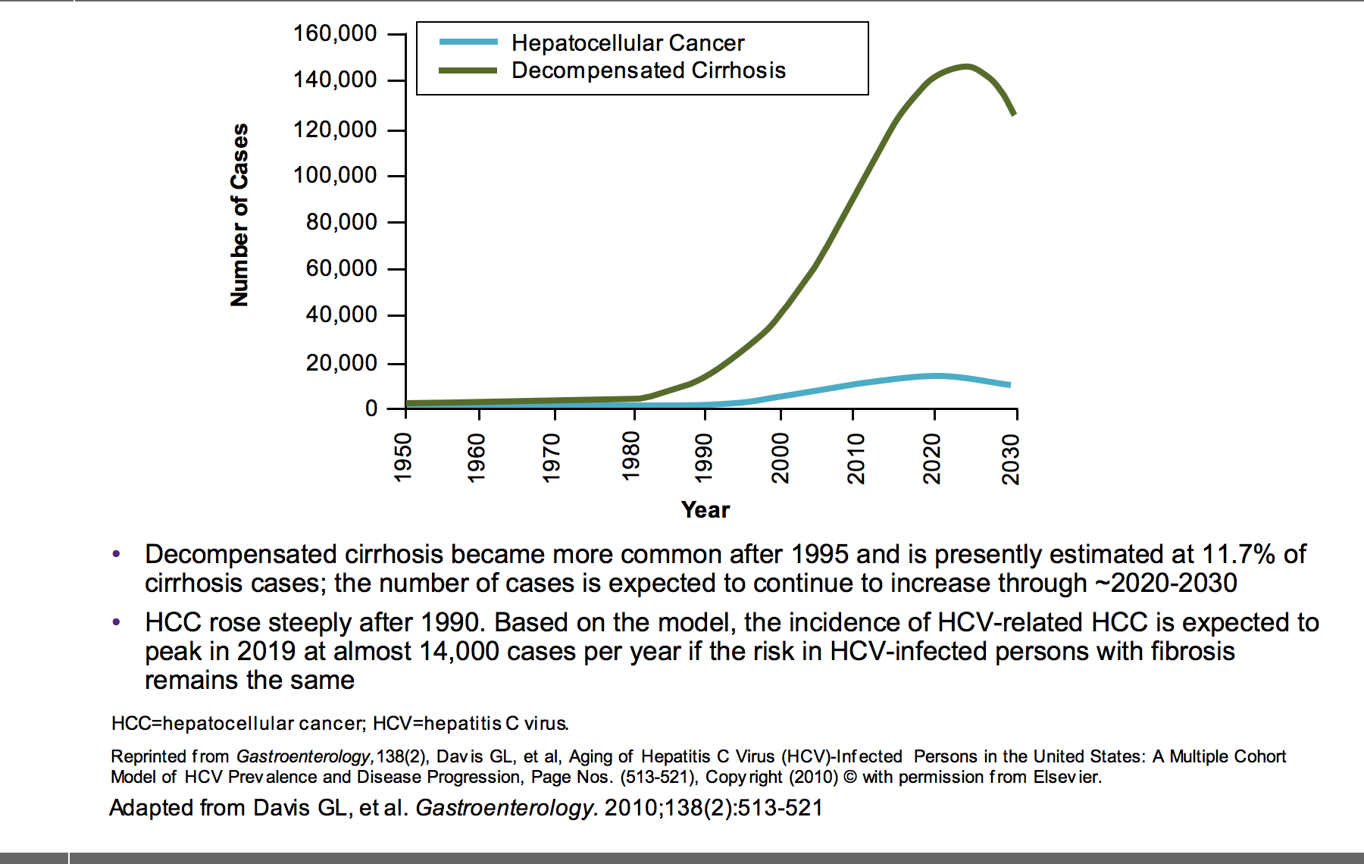
Projected Numbers of Decompensated Cirrhosis and Cases of HCC to Rise Through 2020

Slide 24
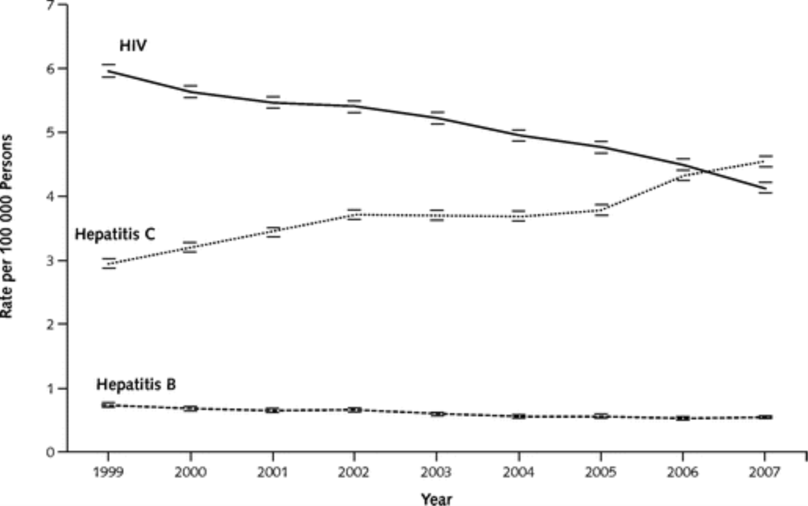
Deaths Due to HCV Infections Now Exceed
Those Due to HIV Infection
15,106
12,734
Number of HCV-related deaths may be over 60,000 because of under-reporting on death certificates
Ly KN et al. Ann Intern Med. 21 February 2012;156(4):271-278; Mahajan, IDSA 2013
Notes:
Key Point
In the United States, the annual number of deaths due to HCV infection are increasing, and have risen above that of HIV infection.1
Notes
In an analysis of ~22 million death certificates from 1999 to 2007, the mortality rate due to HCV infection increased to 15,106 in 2007. During the same timeframe, deaths due to hepatitis B virus (HBV) remained relatively constant (1815 deaths in 2007) and human immunodeficiency virus (HIV)-related deaths decreased slightly to 12,734.1
During the study period, annual deaths due to HCV surpassed that of HIV infection.1
While these data indicate the increasing mortality burden of chronic HCV infection, deaths due to HCV are frequently underreported; thus the accurate mortality is likely to be higher than is captured by death certificates.1,2
References
Ly KN, Xing J, Klevens M et al. The increasing burden of mortality from viral hepatitis in the United Status between 1999 and 2007. Ann Intern Med. 2012; 156: 271-278.
Wise M, Bialek S, Finelli L, Bell BP, Sorvillo F. Changing trends in hepatitis C-related mortality in the United States, 1995-2004. Hepatology. 2008;47:1128-1135.

Slide 25
The best way to reduce the likelihood that someone will develop severe complications of hepatitis C is to cure the infection

Slide 26
Highly Efficacious Treatments Are Not Enough
95% SVR and higher rates of diagnosis/treatment
PEG-IFN/RBV
95% SVR
100%
100%
100%
All HCV
patients
90%
Diagnosis
and treatment
20%
20%
19%
85%
Cure
10%
Slide courtesy of Prof. Michael Manns
Notes:
This slide shows that at the currently diagnosis/treatment rate, better SVR doesn’t make a major different in the cure rate in the infected population. In order to make major progress, more patients need to be diagnosed and treated.

Slide 27
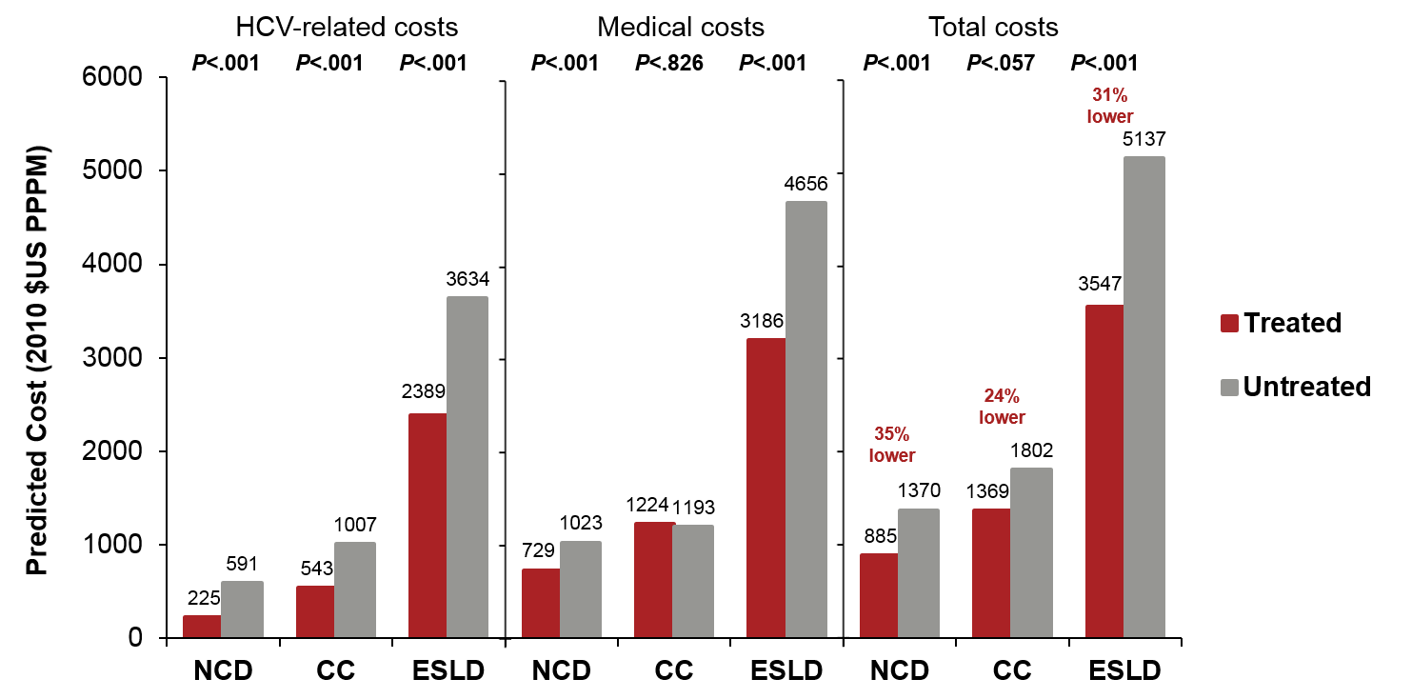
Treating HCV Has Been Shown to Reduce Healthcare Costs in the US
Mean per-patient-per-month (PPPM) follow-up costs
by treatment history and liver disease severity (2010)
HCV-related costs
Medical costs
Total costs
CC = compensated cirrhosis; ESLD = end-stage liver disease; NCD = noncirrhotic disease.
Covariates adjusted for in the analysis included age, sex, geographical region, index year, baseline comorbidities, and baseline treatment for HCV.
Gordon SC, et al. Aliment Pharmacol Ther. 2013;38:784-793.
Notes:
Transition
This graph shows the follow-up HCV-related costs, medical costs, and total costs for treated and untreated chronic HCV patients with noncirrhotic disease (NCD), compensated cirrhosis (CC), and end-stage liver disease (ESLD).
Main Message
Mean HCV-related per-patient-per-month (PPPM) costs (2010 $US) were significantly lower among treated patients in all groups.
Mean follow-up medical PPPM costs were significantly lower among treated versus untreated NCD and ESLD patients, but not CC patients. The CC sample size was small (only 7% of patients).
Mean PPPM costs increased with HCV disease severity. Follow-up costs were 5+ times higher for untreated ESLD versus treated NCD.
Total healthcare costs were significantly lower among treated versus untreated NCD and ESLD patients, but not CC patients.
Background
Costs (data from US private insurance database) were adjusted for demographic characteristics, comorbidities, index year, geographical region, and treatment.
Adjusted costs (shown on the slide)
Mean follow-up PPPM costs were significantly lower among treated versus untreated NCD and ESLD patients, but not CC patients (NCD: 35% lower; ESLD: 31% lower; CC: 24% lower).
Unadjusted costs
Mean follow-up PPPM costs were significantly lower among treated versus untreated NCD and ESLD patients, but not CC patients.
NCD: 35% lower ($900 versus $1378 untreated; P<.001).
ESLD: 30% lower ($3634 versus $5071 untreated; P<.001).
CC: 22% lower ($1404 versus $1795; P<.071).
Conditions or procedures used to assign patients to liver disease severity groups based on diagnosis or procedure codes
NCD: No listed conditions or procedures.
CC: Cirrhosis.
ESLD: Liver transplant, HCC, liver failure including hepatorenal syndrome, hepatic encephalopathy, portal hypertension, esophageal varices, other gastrointestinal hemorrhage, ascites, other sequelae of chronic liver disease, abdominal paracentesis procedures, shunts and catheter procedures, treatment of varices, and portal decompression procedures.
Reference
Gordon SC, et al. Aliment Pharmacol Ther. 2013;38:784-793.
27

Slide 28
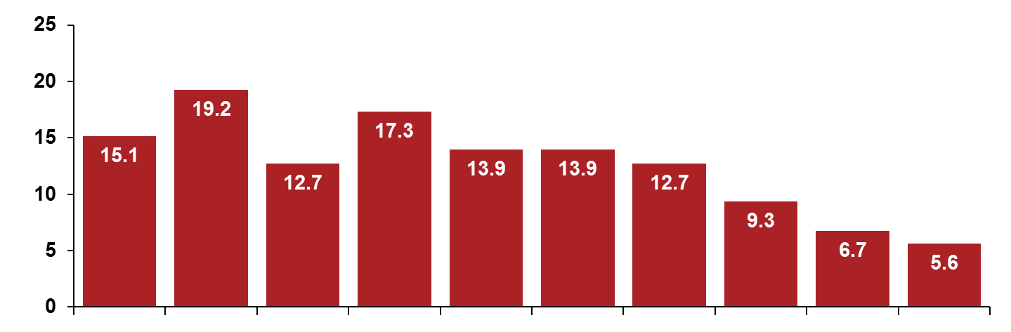
SVR Was Associated with Improved Quality of Life in a Real-World Clinic Population
A study of community patients from hospitals in Vancouver has shown that sustained responders reported higher scores than treatment failures on each domain of the SF-36 and on utility measures
Mean difference in scores (SVR versus treatment failure)
*
†
*
†
†
†
†
Mean Difference
†
*
≠
Bodily Pain
General Health
Physical Functioning
Role Physical
Role Emotional
Social Functioning
Vitality
Mental Health
PCS
MCS
SF-36 Scales
This analysis was part of a larger study examining the quality of life and economic burden of HCV in community patients recruited from 5 clinical settings in Vancouver, British Columbia, and included a cross-sectional administration of questionnaires with retrospective review of medical records. Of these, 235 patients (133 responders and 102 treatment failures) completed questionnaires at an average of 3.7 years after end of treatment. Patients with advanced liver disease were excluded.
Sustained responders = undetectable HCV viral levels 6 months after therapy; treatment failures = detectable HCV viremia after therapy, or patients with an end-of-treatment response who relapsed.
MCS = mental summary score (0-100); PCS = physical summary score (0-100). *P<.0001; †P<.001; ≠P<.01.
John-Baptiste AJ, et al. Am J Gastroenterol. 2009;104:2439-2448.
Notes:
Transition
This slide shows that achieving SVR may improve quality-of-life scores.
Main Message
Patients who achieved SVR reported significantly higher scores than treatment failures on all domains of the SF-36.
Background
This analysis was based on a cross-sectional administration of questionnaires and on a retrospective review of medical records. It was part of a larger study examining the quality-of-life burden of HCV in a community-dwelling population.
A convenience sample was made up of 657 CHC patients from 5 healthcare settings in Vancouver, British Columbia, who were treated from 2006-2008. Of these, 235 subjects were included in the analysis (133 responders and 102 treatment failures).
After adjustment for age, sex, ethnicity, marital status, education, Charlson comorbidity, and Index of Coexistence Disease scores using multivariable linear regression, SVR was significantly associated with higher SF-6D score (0.05; 95% confidence interval [CI], 0.02, 0.08), physical summary score (5.73; 95% CI, 3.24, 8.22), and mental summary score (5.22; 95% CI, 2.07, 8.37).
Reference
John-Baptiste AJ, et al. Am J Gastroenterol. 2009;104:2439-2448.

Slide 29
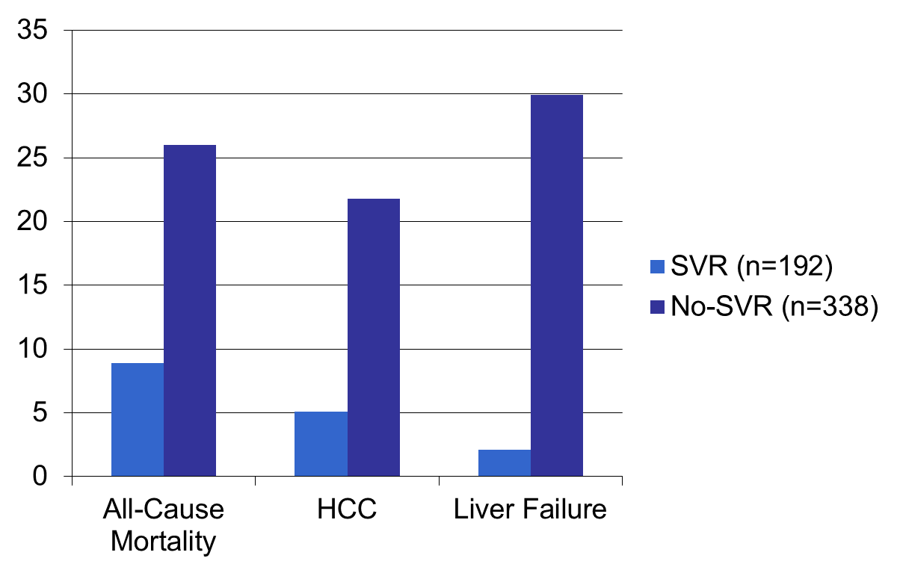
SVR (Cure) Associated with Decreased All-Cause Mortality
29.9
26
21.8
10-year Cumulative Incidence Rate
8.9
5.1
530 patients with advanced fibrosis, treated with interferon-based therapy, and followed for 8.4 (IQR 6.4-1.4) years
2.1
Van der Meer et al. JAMA 2012; 308:2584

Slide 30
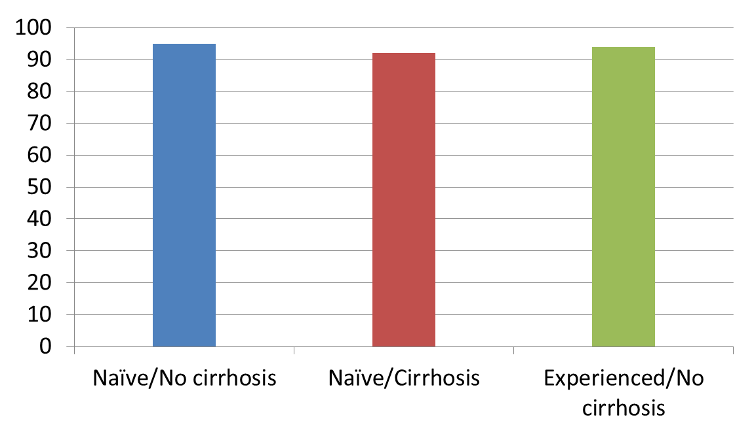
SVR in Genotype 2 Patients Treated with Sofosbuvir+Ribavirin for 12 Weeks
Percent SVR
Treatment experienced, cirrhotic patients only had a 78% SVR with 16 weeks SOF+LDV. May wait for sofosbuvir + daclatasvir
EASL 2014

Slide 31
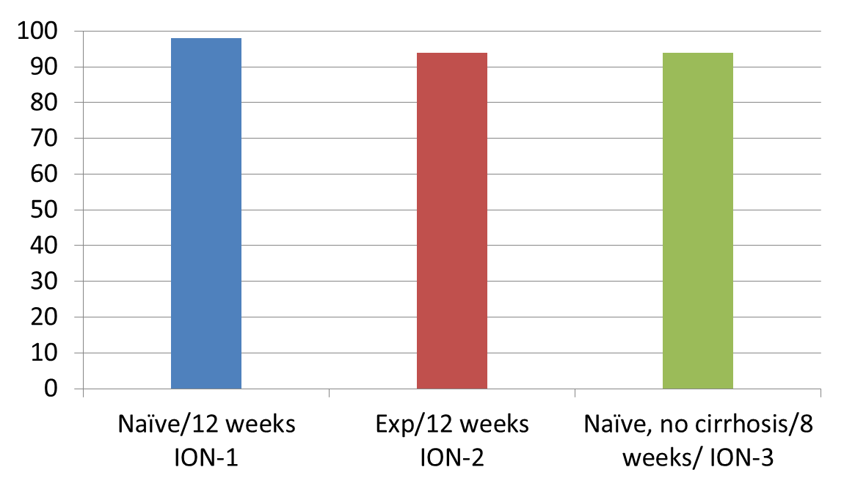
SVR-12 in Genotype 1 Patients Treated with Sofosbuvir+Ledipasvir (FDC)
Gilead Phase 3 Program:
-Genotypes 1a and 1b combined for all studies
-ION-1 with 15.7% cirrhosis
-ION-2 with 20% cirrhosis
-FDA approval anticipated by October 10, 2014
Percent SVR
N=214
N=109
N=215
EASL 2014

Slide 32
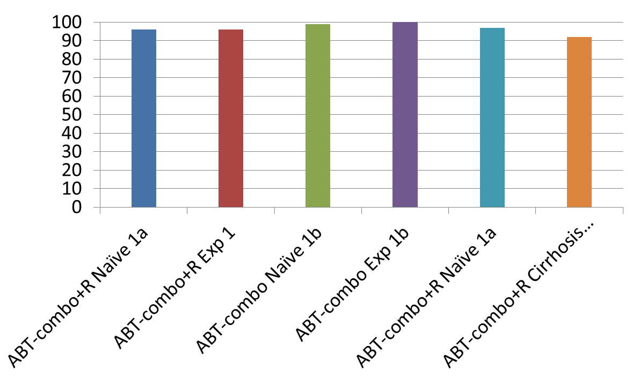
SVR-12 in Genotype 1 Patients Treated with ABT-450/RTV, ABT-267, ABT-333 +/- RBV (3-D)
Phase 3 AbbVie program:
-All 12 week treatment arms
-Geno 1b no RBV
-Geno 1a with RBV
-All studies excluded cirrhotic patients expect TURQUOISE-II* (all genotype 1, both naïve and treatment experienced)
-FDA approval anticipated in December, 2014
Percent SVR
N=473
N=297
N=209
N=91
N=100
N=208*
Feld; NEJM 2014 Apr 11; Zeuzem; NEJM 2014 Apr 10; Poordad NEJM 2014 Apr 12; [e-pub ahead of print]

Slide 33
Other Tools
Test and counsel !

Slide 34
Rate of Liver Progression is Affected by Several Patient Factors
Male gender¹
Age at infection¹
Comorbidities such as HIV and HBV status¹
High levels of alcohol consumption¹
Immune status¹
Visceral obesity with steatosis^{2,3}
Diabetes⁴
Insulin resistance⁵⁻⁷
Synergy between risk factors⁸
Metabolic Syndrome
Affects 37–54% of adults over 40 years old⁹
1. Chen SL, Morgan TR. Int J Med Sci. 2006;3(2):47-52. 2. Adinolfi LE, et al. Hepatology. 2001;33(6):1358-1364. 3. Adinolfi LE. Expert Rev Gastroenterol Hepatol. 2013;7(3):205-213. 4. El-Serag HB, et al. Clin Gastroenterol Hepatol. 2006;4(3):369-380. 5. Bugianesi E, et al. J Hepatol. 2012;56(suppl 1):S56-65. 6. Mohamed HR, et al. Int J Health Sci (Quassim). 2009;3(2):177-186. 7. Khattab MA, et al. Ann Hepatol. 2012;11(4): 487-494. 8. Loomba R, et al. Am J Epidemiol. 2013;177(4):333-342. 9. Ervin RB. Natl Health Stat Report. 2009;(13):1-7.

Slide 35
Initial Qualitative Serological Screening Tests for Anti-HCV
Tests Approved for Clinical Use | Description
Abbott HCV EIA 2.0 (Abbott Laboratories, Abbott Park, IL) | Enzyme immunoassay
Ortho® HCV Version 3 ELISA Test System (Ortho-Clinical Diagnostics, Raritan, NJ) | Enzyme-linked immunosorbent assay
Oraquick® HCV Rapid Antibody Test (Orasure Technologies, Bethlehem, PA) | Immunoassay
Vitros® Anti-HCV Assay (Ortho-Clinical Diagnostics, Raritan, NJ) | Immunometric assay
Adapted from Albeldawi M et al. Cleve Clin J Med 2010;77:616-626.
Oraquick available at http://www.fda.gov/default.htm. Accessed 12/4/14.

Slide 36
Rapid, Point of Care
HCV Antibody Test
OraQuick
  Only test approved by FDA in the US for use in detecting HCV antibodies in venous whole blood specimens
  Provides results in 20 minutes
  Appropriate for use in physician offices, ERs, and public health clinics and facilities
  Allows patient to not be lost to follow-up
Available et al http://www.accessdata.fda.gov/cdrh_docs/pdf8/P080027c.pdf. Accessed 12/4/14.

Slide 37
Is Positive Anti-HCV Test Result a Diagnosis for Chronic HCV Infection
A positive anti-HCV test result is not a diagnosis for chronic HCV infection
Some individuals become infected with HCV and then spontaneously clear the infection
Approximately 15%–25% of persons clear the virus without treatment and do not develop chronic infection; the reasons for this are not well known
Centers for Disease Control and Prevention. Available at
http://www.cdc.gov/hepatitis/HCV/HCVfaq.htm. Accessed 12/4/14.

Slide 38
Positive HCV Ab Test
Should be Confirmed With a HCV RNA Assay

Slide 39
Interpreting Hepatitis C Test Results
Anti-HCV | HCV RNA (PCR) | Interpretation
Negative | Negative | No infection
Positive | Positive | HCV present (acute or chronic infection)
Negative | Positive | Chronic infection in immunosuppressed patient Early infection
Positive | Negative | Resolved infection Treated infection, HCV below detectable levels (verify with qualitative HCV RNA PCR) False-positive anti-HCV test (<1%)
Albeldawi M et al. Cleve Clin J Med 2010;77:616-626.

Slide 40
Counseling Patients Newly Diagnosed with Chronic Hepatitis C
There is a low but present risk for transmission with sex partners
Sharing personal items that might have blood on them, such as toothbrushes or razors, can pose a risk to others
Cuts and sores on the skin should be covered to keep from spreading infectious blood or secretions
Donating blood, organs, tissue or semen can spread HCV to others
Centers for Disease Control and Prevention. Available at
http://www.cdc.gov/hepatitis/HCV/HCVfaq.htm. Accessed 12/4/14.

Slide 41
Counseling Patients Newly Diagnosed with Chronic Hepatitis C (cont)
Avoid alcohol because it can accelerate cirrhosis and end-stage liver disease
Check with a health professional before taking any prescription pills, over-the-counter drugs (such as analgesics), or supplements as these can potentially damage the liver
Get vaccinated for HBV and HAV
Centers for Disease Control and Prevention. Available at
http://www.cdc.gov/hepatitis/HCV/HCVfaq.htm. Accessed 12/4/14.

Slide 42
Link to Care For Those Found to be HCV RNA Positive is Essential
The first step in the management of HCV is appropriate linkage
to care
Link to care is evaluation by a practitioner who is prepared to provide comprehensive management, including consideration of antiviral therapy
Treatment is recommended for patients with chronic HCV infection
HCV-positive persons should be evaluated (by referral or consultation, if appropriate) for the presence of advanced fibrosis. This:
  facilitates an appropriate decision regarding HCV treatment strategy
  determines the need for initiating additional screening measures (eg, hepatocellular carcinoma [HCC] screening)
Available at http://www.hcvguidelines.org/full-report/hcv-testing-and-linkage-care. Accessed 12/4/14.

